Slide 1
Open Source Satellites
Notes:
Thank you!
There are at least three audiences here: Hams, IEEE Computer, IEEE Communications.
I want to tell some stories and answer your questions.
Open Source refers to software for which the original source code is made freely available and may be redistributed and modified. There are a variety of licenses that further refine this definition. This is in contrast to proprietary software, where the original source code is not made available outside the developers or people that have NDAs or licenses to see it. The open-source movement in software and hardware has dramatically changed our engineering culture and economy for the better. Linux, Wikipedia, Apache, Project Gutenberg, Atom, GitLab, OpenSCAD, and Eclipse are only a few successful open source projects that have enabled enormous quantities of productive work and innumerable lucrative endeavors. Questions of "Why would someone sell a software product for free?" and "Why should anyone participate in a project that does not reap financial rewards?" are routinely answered by evidence of the enormous value of collaborative organizations and their work products. Most software that is written is never intended to be sold. Instead, it is intended to solve a problem for a business that does something other than sell software. For example, for academia, or to solve some individual need. So, the question "why share software instead of sell it" is the wrong question. "How can I share the cost of making this software that I never intended to sell, make it better, and get the benefit other people's work and ideas" is a better question, and the natural answer is Open Source. Open-source hardware, championed by Bruce Perens and the Maker Movement, has had a more difficult time finding solid legal ground than open-source software. Despite this, open-source hardware continues to gain influence across educational, scientific, and consumer markets. Repatriating proprietary knowledge to the commons is a mission of many hardware hackers and open-source activists. Knowledge in the commons is considered to be of great benefit. With open-source on the ascendancy, and all the obvious advantages, amateur radio seems to be the perfect place for open-source software to triumph. This is not universally true. The relatively small amateur radio market means that proprietary software can and does remain dominant in some categories. However, amateur radio experimenters have access to and an increasingly large amount of involvement within one of the most interesting and powerful open source projects in the radio world: GNU Radio. GNU Radio is a free and open source toolkit for software radio. Software defined radio is absolutely essential to all modern radio research and has already made a profound difference commercially. The trend will continue with deep learning and cognitive radio essentially re-writing the landscape of how radio is used by the public and how it is regulated by governments. In one particular area of amateur radio, the open source movement runs into a special and somewhat unique challenge. The amateur radio service includes satellites. The history of amateur satellite service in the United States dates back to 1961 when the satellite Oscar 1 hitch-hiked a ride to space along with a government spy satellite. Quietly, hams pursued a half-century long, astonishingly successful private space program that is still little-known outside of ham radio today, but has launched over 80 satellites, almost all of them as hitch-hikers along with other payloads that were the main purpose of the launch. You can find a list of what's currently in orbit and active from AMSAT.org, the website for Amateur Satellite Corporation.
The challenge that we face as amateur satellite developers? Communications satellites were regulated as munitions under ITAR for many years. ITAR is the International Traffic in Arms Regulations. It is a set of United States regulations that restrict and control the export of defense and military related technologies to safeguard U.S. national security and further U.S. foreign policy objectives. The stated mission of amateur radio in the United States, which is to support advancement of the radio arts, education, emergency response, and includes language encouraging amateur radio operators to contribute to international goodwill runs into a brick regulatory wall with ITAR. Both amateur and commercial satellite development in the United States were very negatively impacted by ITAR. Open Source development, which we pursue, is all about openness and sharing. Contrast that with ITAR, which is about keeping knowledge away from countries that might use it to our peril, like North Korea. Today will talk about the impact of regulatory decisions on the collaborative history of AMSAT, the current efforts to get back on track within AMSAT, how one particular AMSAT project was restructured to avoid ITAR, and how both AMSAT-DL and AMSAT-NA are working together to implement an amateur-radio centric open source version of DVB-S2 for use in amateur satellite payloads and satellite simulators. Technical details of the DVB-S2 and S2X protocol will be discussed. This project is called Phase 4 Ground and is ongoing.

Slide 2
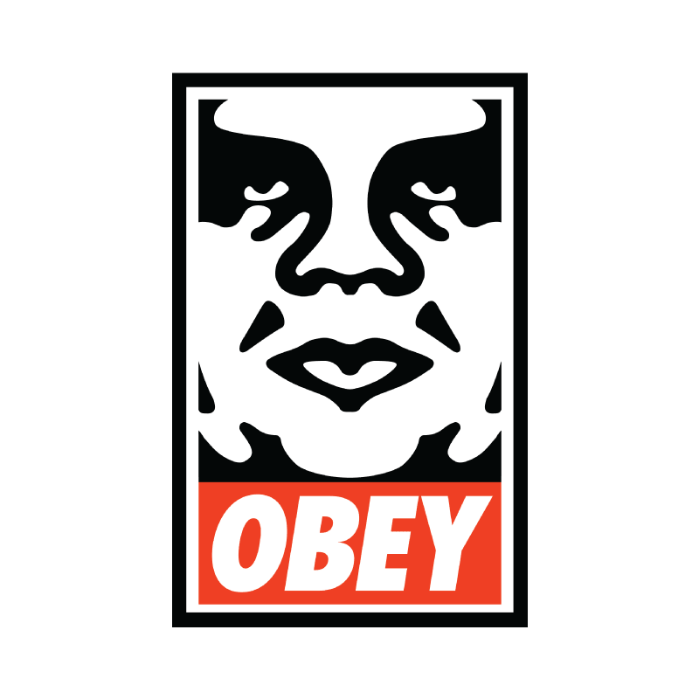
INSTRUCTIONS FOR USE
Weigh and Consider! (Harold Bloom “How to Read and Why”) Disobey!
Experiment!
Participate!
Enjoy!
More info on how to use this and many other presentation templates at www.slidescarnival.com/help-use-presentation-template Templates used are free to use under Creative Commons Attribution license. You can keep the Credits slide or mention SlidesCarnival and other resources used in a slide footer.
Notes:
Award the sweater! Best holiday decoration!

Slide 3
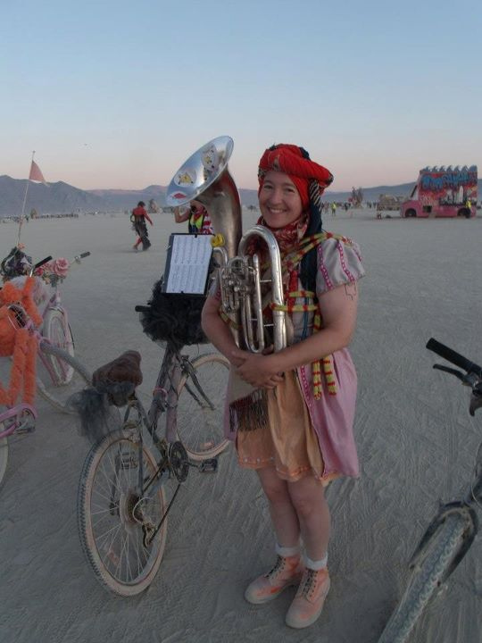
HELLO!
I am Michelle W5NYV
I enjoy thinking and doing!
Not necessarily in that order!
BSETx2, math minor, MSEE Info Theory USC, DEFCON, Burning Man, AMSAT, IEEE, GNU Radio, Gator (punk rock), 2nd lines, street bands, community orchestras, pipe organ construction, Organ Donor lead, Phase 4 Ground lead
https://phase4ground.github.io/
Notes:
IEEE makes me put this in here
The also told me no swearing and not to start any bar fights. That’s a music joke. I am a practitioner.

Slide 4
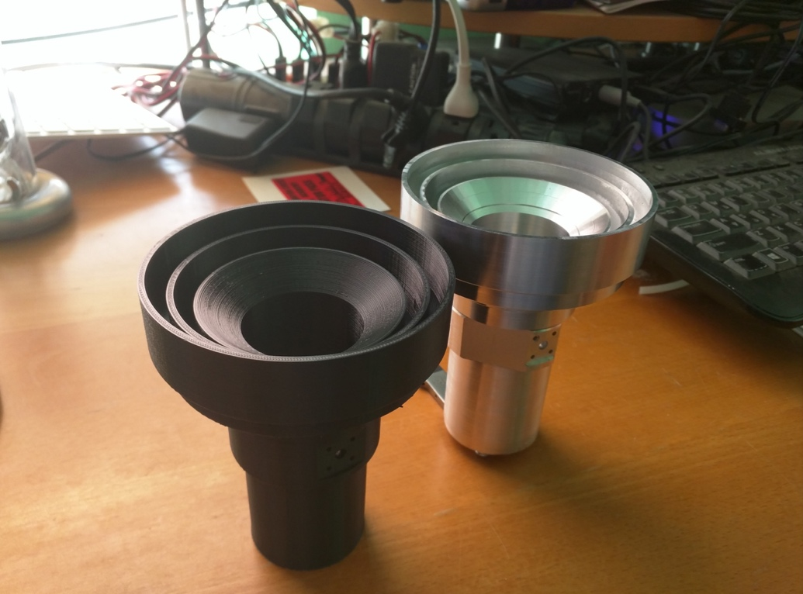
Notes:
I am a practitioner. But I do not practice law.
I am not a lawyer. Do not construe anything that I say as legal advice.
I will be talking about an area of law that has serious consequences but it’s almost impossible to tell if you’ve violated the law until it’s too late.
All of us that work on amateur radio satellites have been affected by the constant threat of these specific legal consequences.
Almost without exception, those of us that work on amateur radio satellites really hate the laws that prevent us from doing reasonable and productive good faith engineering activity. This hatred is visceral because the laws in question have had enormous unintended repercussions that administration after administration has failed to completely address.
Lots of us have ragequit. One of the biggest reasons I have for speaking to you today is because IEEE as an organization can be a force for good in addressing this situation. Engineering needs representation and advocacy. IEEE actively lobbies. They spent 80k in 2016 and 70k in 2017 as of October. Part of your dues get us a toehold in the government. Help them. As active engineers, consider running for office.
Contact staffers about issues you know about and offer your expertise. Get active.

Slide 5
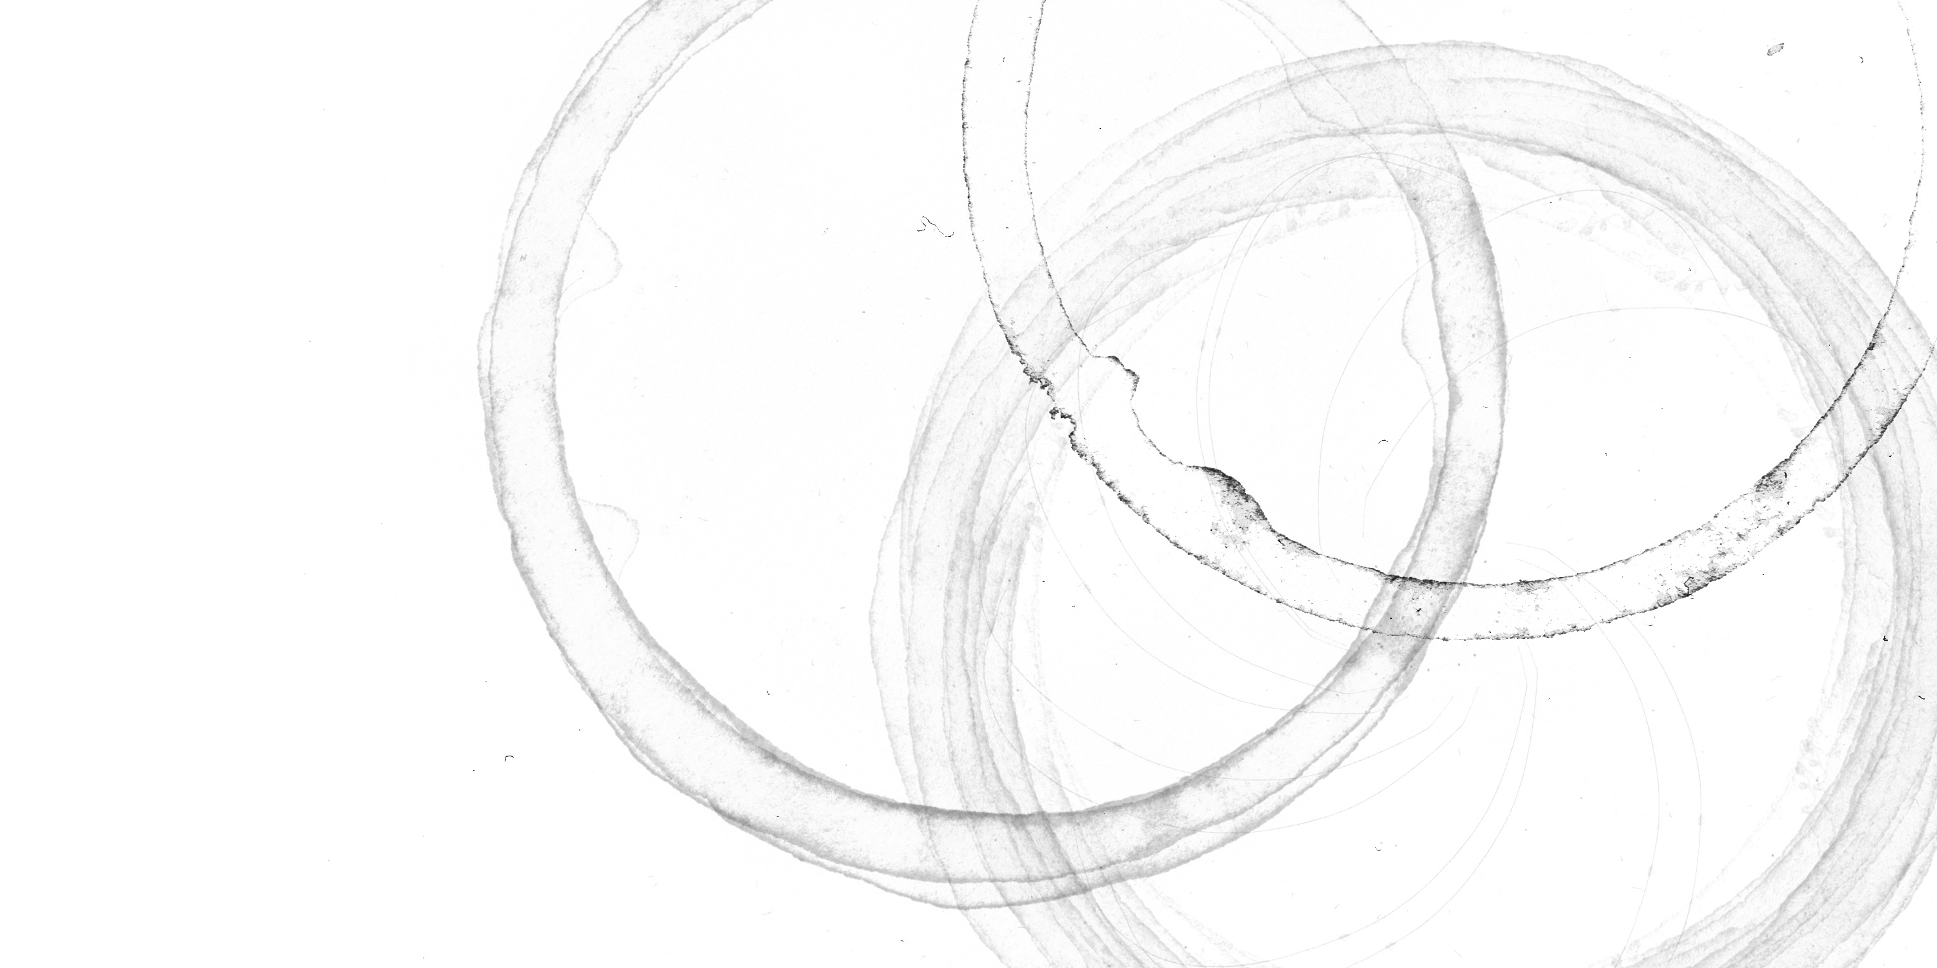
Notes:
The One True Slide.
We live in worlds of overlapping coffee rings.

Slide 6
AMSAT
Notes:
How many of you are amateur radio operators? If not, get your license. It’s easy and just like that you’re 3dB more hip.
How many of you are VEs? These are the people you need to talk to. Amateur radio is a government licensed service that allows use of radio frequency spectrum for purposes of
non-commercial exchange of messages
wireless experimentation
self-training
Recreation
Radiosport
Contesting
emergency communication. This is in contrast to commercial broadcasting, public safety (such as police and fire), or professional two-way radio services (such as maritime, aviation, taxis, etc.). Each country administers its own licensing scheme and these government bodies coordinate with each other through the International Amateur Radio Union (IARU). The amateur radio service includes satellites. The history of amateur satellite service in the United States dates back to 1961 when the satellite Oscar 1 hitch-hiked a ride to space along with a government spy satellite. Quietly, hams pursued a half-century long, astonishingly successful private space program that is still little-known outside of ham radio today, but has launched over 90 satellites, almost all of them as hitch-hikers along with other payloads that were the main purpose of the launch.
Yesterday was the 56th anniversary of Oscar 1.
Secondary or hosted payloads are both our past and future.

Slide 7
AMSAT.org
Notes:
You can find a list of what's currently in orbit and active from AMSAT.org, the website for Amateur Satellite Corporation. It’s a 501c3 organization.

Slide 8
AMSAT
Open
Source
Notes:
Open Source
How many of you use open source every day?
Google, amazon!
Open Source refers to software for which the original source code is made freely available and may be redistributed and modified. There are a variety of licenses that further refine this definition. This is in contrast to proprietary software, where the original source code is not made available outside the developers or people that have NDAs or licenses to see it. The open-source movement in software and hardware has dramatically changed our engineering culture and economy for the better. Linux, Wikipedia, Apache, Project Gutenberg, Atom, GitLab, OpenSCAD, and Eclipse are only a few successful open source projects that have enabled enormous quantities of productive work and innumerable lucrative endeavors. Like Google. And Amazon. Open source moves the value conditions further out to the edges, so that we can conquer entirely new areas, have new products, new capabilities, and advance computer science. We often hear questions like "Why would someone sell a software product for free?" and "Why should anyone participate in a project that does not reap financial rewards?" Most software that is written is never intended to be sold. Instead, it is intended to solve a problem for a business that does something other than sell software. For example, to solve an academic problem, or to solve some individual need, or to duct tape something together long enough for the hardware to catch up. So, the question "why share software instead of sell it" is the wrong question. "How can I share the cost of making this software that I never intended to sell, make it better, and get the benefit other people's work and ideas" is a better question, and the natural answer is to open the source. There are a lot of proprietary punishments. Updates. Defending the secrecy. Curated critique. That’s software. But satellites aren’t made out of software. Chunks of metal and radio parts go up there. And that’s hardware. Open-source hardware, championed by Bruce Perens and the Maker Movement, has had a more difficult time finding solid legal ground than open-source software. Despite this, open-source hardware continues to gain influence across educational, scientific, and consumer markets. Repatriating proprietary knowledge to the commons is a mission of many hardware hackers and open-source activists. Knowledge in the commons is considered to be of great benefit. So far so good, right? Amateur radio… open source…

Slide 9
ITAR
AMSAT
Open
Source
Notes:
The biggest challenge that we face as amateur satellite developers?
Communications satellites have been regulated as munitions under ITAR since 1976. Before that, things were very different. You could have open and international collaborations.
ITAR is the International Traffic in Arms Regulations administered by the state department. There’s another set of regulations called EAR administered by the commerce department.
ITAR is a set of United States regulations that restrict and control the export of defense and military related technologies to safeguard U.S. national security and further U.S. foreign policy objectives.
The stated mission of amateur radio in the United States, which is to support advancement of the radio arts, education, emergency response, and includes language encouraging amateur radio operators to contribute to international goodwill runs into a regulatory brick wall with ITAR.
Both amateur and commercial satellite development in the United States have been very negatively impacted by ITAR.
Spacenews, 2004 “WASHINGTON — One of the architects of the U.S. regulations restricting the export of U.S. satellites and components now says the rules need a thorough overhaul because they are damaging U.S. industry with no corresponding benefit to U.S. national security.”
The Economist, 2008 “Yet rarely has such a reasonable aim been so self-defeating. The system of export controls, known as the International Traffic in Arms Regulations (ITAR), is managed with almost comic zeal by the State Department. Anything that is part of a satellite assembly needs vetting—even if it is as common as a lithium-ion battery, as insignificant as a screw or as innocuous as a stand for a satellite. The cost, delays and inconvenience of dealing with the American space industry are exasperating enough to send its foreign partners into orbit. Which is exactly where they have been going—on their own. The American space industry's share of commercial-satellite manufacturing has fallen from over 80% before 1999 to 50% now. ”
Spacenews, 2012 PARIS — A U.S. State Department investigation of whether European satellite manufacturer Thales Alenia Space has illegally included sensitive U.S.-built satellite parts in spacecraft launched aboard Chinese rockets has remained open for more than three years because of a dispute over what information Thales should be required to submit, according to a company official and State Department documents.
The Economist, 2013 “Stuck to the ground by red tape Space technology: Dozens of firms want to commercialize space in various ways. Bureaucracy, not just gravity, is holding them back” Long article about the damage to innovation and market share. The Economist, 2014 “Barack Obama’s administration has sensibly repealed a law of 1999 that required all satellites to be licensed by the State Department as munitions under the International Traffic in Arms Regulations (ITAR). This could mean that most commercial satellites will be removed from ITAR by the end of the year and their export administered by the Commerce Department. But some satellite systems and spacecraft—including anything that can carry people into space—will remain under ITAR. Care needs to be taken with military kit, but America’s regulations still seem excessive. A regular review to distinguish between systems that pose a real threat and ones that don’t would be a help, as would better intelligence. Tight restrictions on new technologies will not work, and will damage America’s interests: exciting new ventures like nanosats will simply move to countries from which they can be launched with greater ease.” Open Source development, which we pursue, is all about openness and sharing. Contrast that with ITAR, which is about keeping knowledge away from countries that might use it to our peril, like North Korea.

Slide 10
AMSAT
ITAR WINS!!!
Open
Source
Notes:
So for amateur radio satellites these days it kind of feels like this.
ITAR wipes out open source and all the benefits for us, and rendered AMSAT a sad scared organization that loses its amazing international collaborators, and started making decisions based on fear uncertainty and doubt.
This such a huge contrast with early Oscar teams that Jeffrey Pawlan talked about.

Slide 11

AMSAT
ITAR WINS!!!
Open
Source
Notes:
I mean really. It sucks.
Traditionally in AMSAT ground teams are included along with the payload team, if we even exist. Legacy amateur radio systems use commercial off the shelf gear for their satellites. VHF UHF FM repeaters. That’s what’s in the brand new satellite modeled here. The payload package is essentially an FM repeater. This is a 1:1 scale model of Fox1B, number 91, just launched. <pass around model>
The point is you didn’t need to do much to transceive with a legacy architecture. You just buy normal VHF/UHF ham gear, the right antenna, get some satellite pass predictions, and go chase it down. Anyone done this?
But this radio and payload all under ITAR does not work so well when you want to do something that needs new radios. Like broadband microwave ham radio satellites and platform as a service. We have to provide real microwave radio stations, and getting tied up with ITAR makes this especially annoying.

Slide 12

?
AMSAT
But there is an exemption…
Open
Source
Notes:
There is one very important ITAR exemption. It is for things in the public domain.
What does public domain mean? How is it defined? How can you show what’s in the public domain in an audit?
This is a great exemption, if you know how to use it, and if you have enough guts to use it.

Slide 13
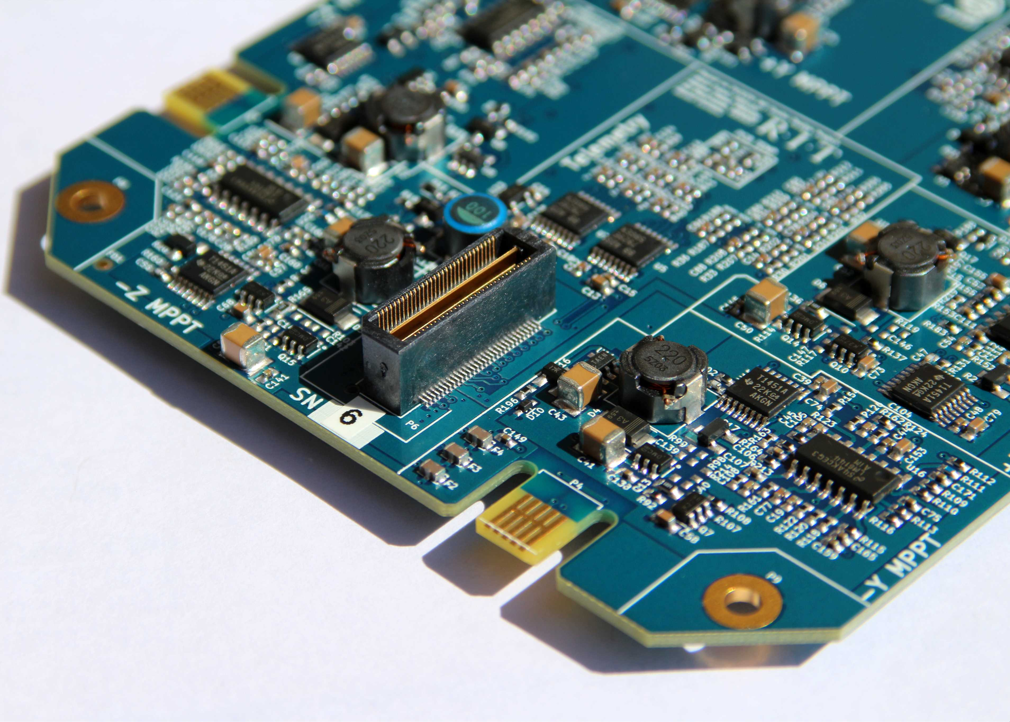
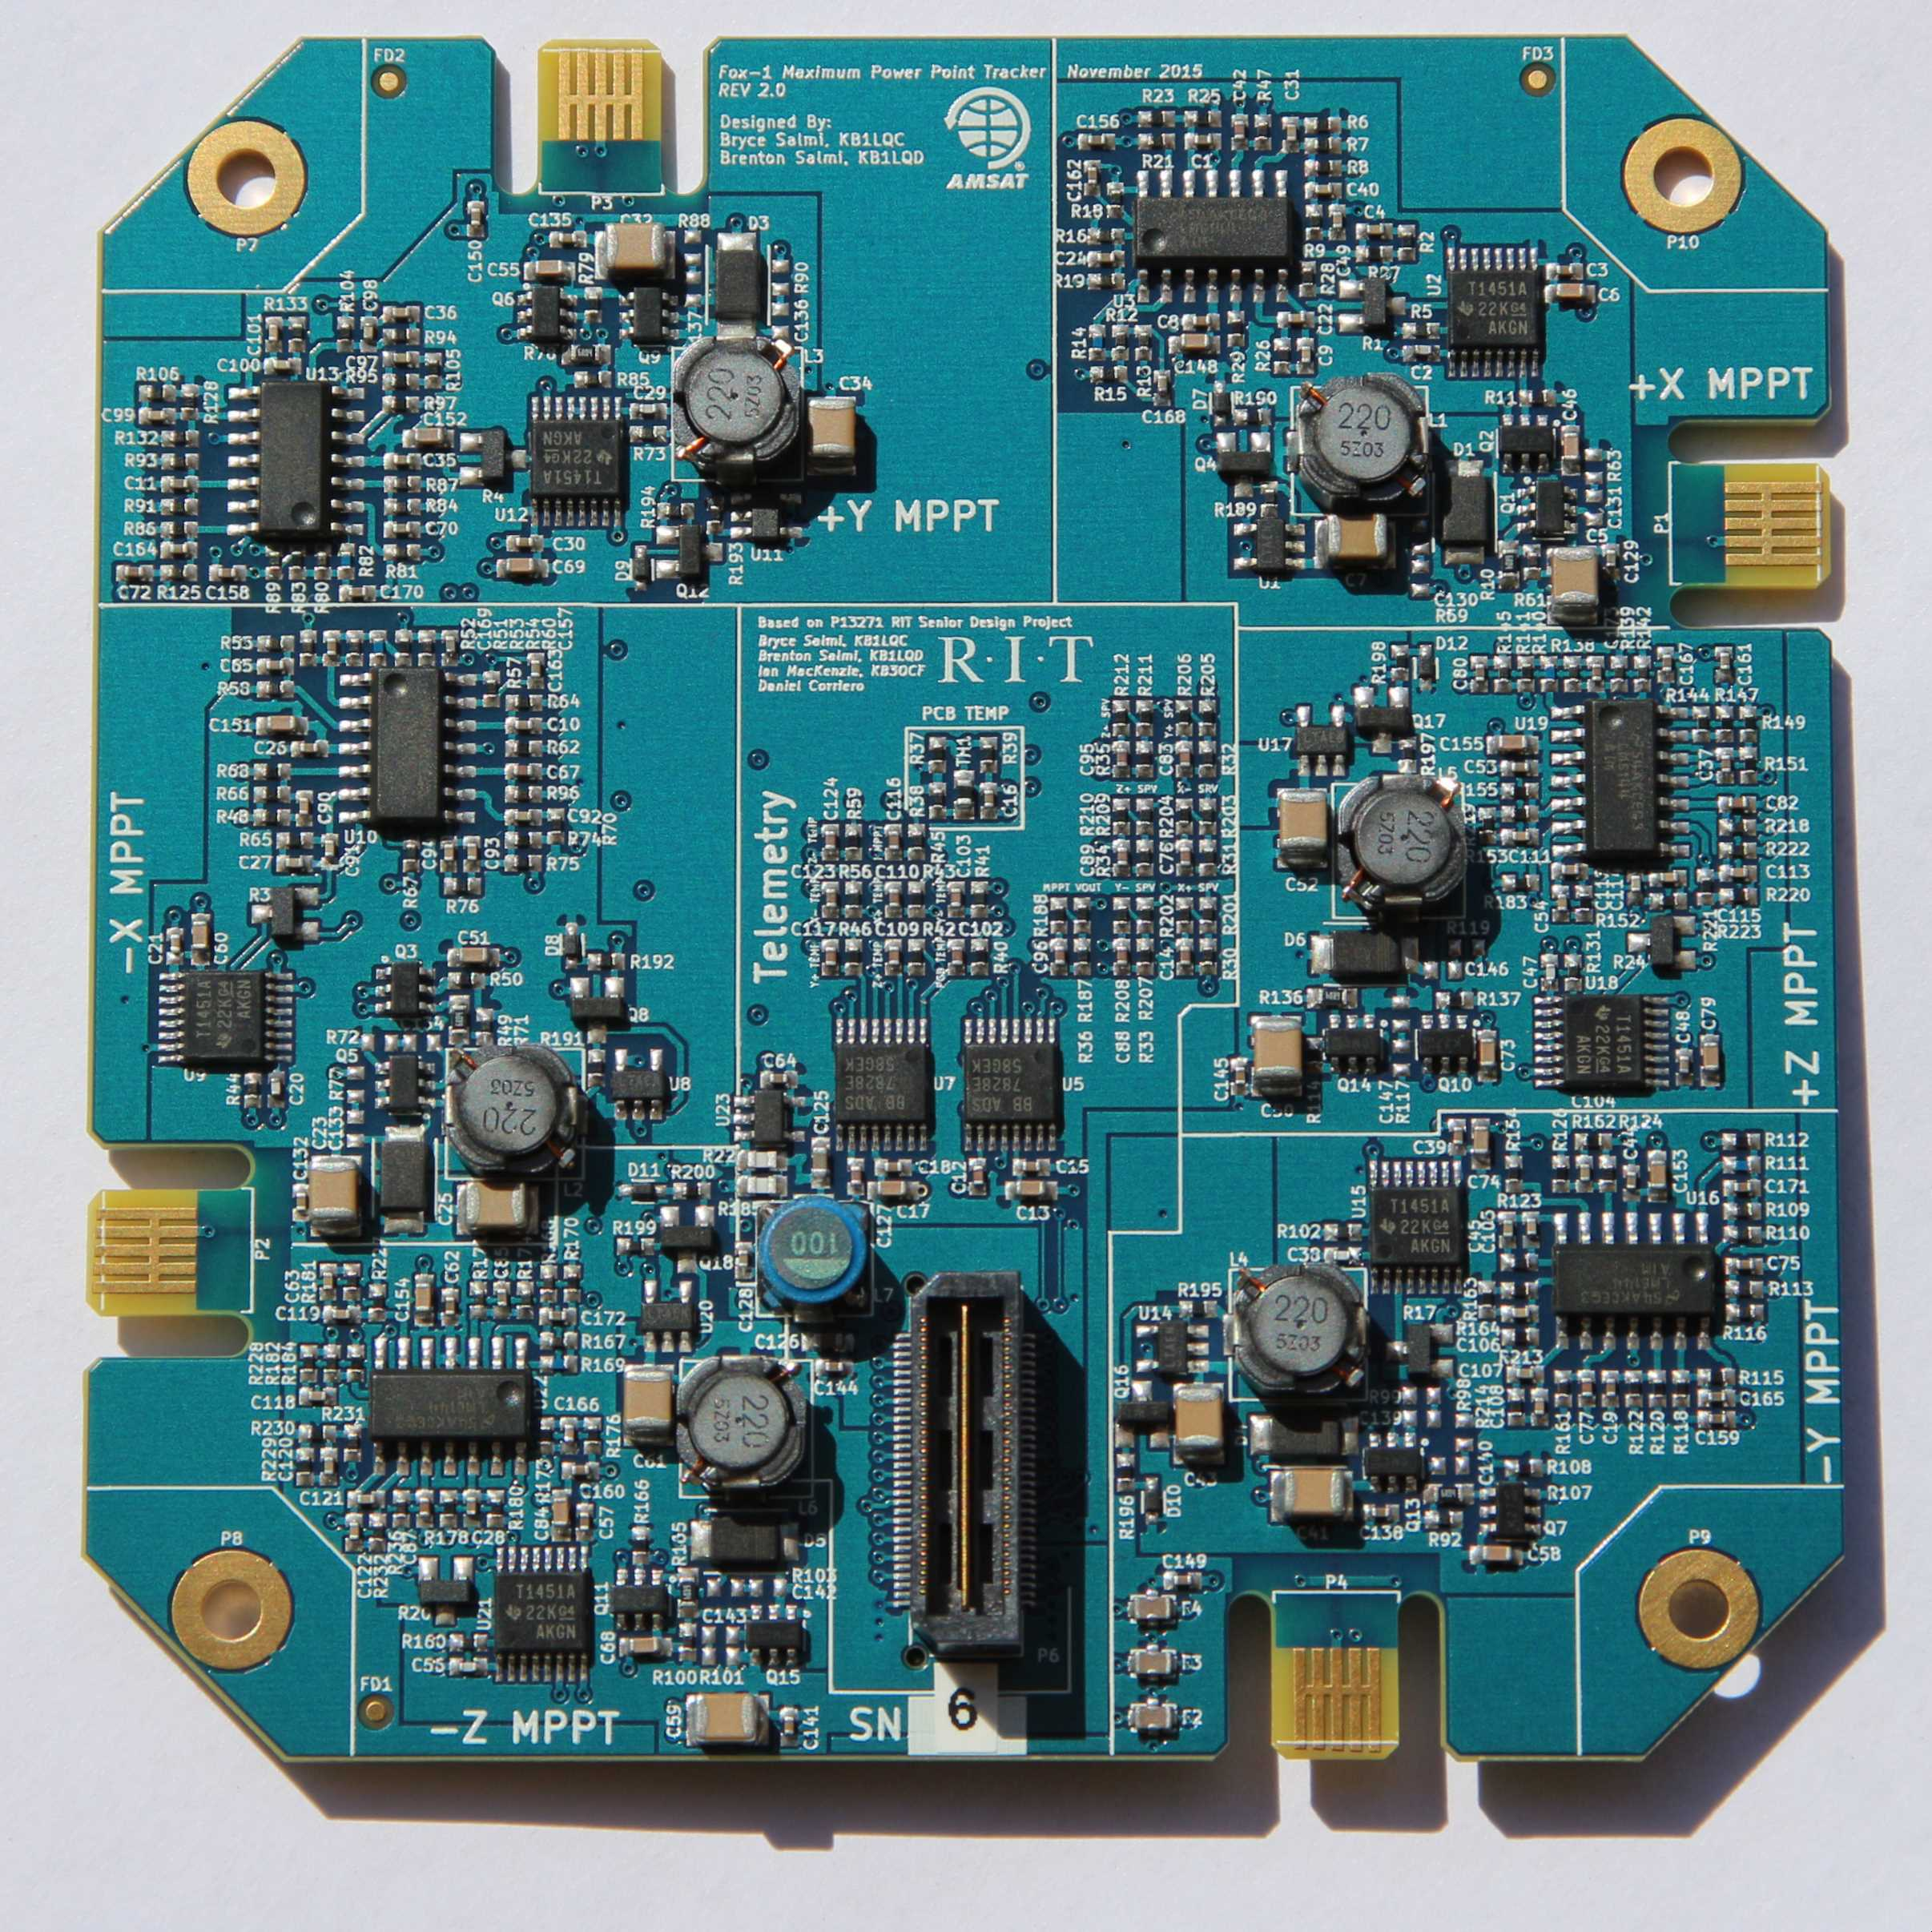
Fox-1 Maximum Power Point Tracker
Started at Rochester Institute of Technology (RIT) in 2012
Two years development after graduation by Brenton & Bryce Salmi (FaradayRF)
One analog computer per solar panel implementing Y = -mX + b to predict solar panel maximum power point voltage based on panel temperature
Currently on-orbit in AO-91 (RadFxSat)
More Than Radios – AMSAT MPPT blog post details the project
Design Files on GitHub
Notes:
12/29/17
13
13
What does it look like when this works? Check this out!

Slide 14
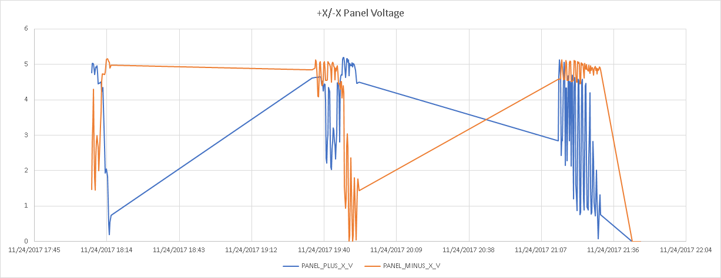
Fox-1 Maximum Power Point Tracker
Peak power is obtained from solar cells between 4.3V at +60C and 5.8V at -60C
Below are plots of -X and +X solar panel voltage on AO-91 shortly after launch
You can see clearly how MPPT is performed on the panels around 4.8V
Small oscillations are panel irradiance changing with spacecraft spinning
Notes:
12/29/17
14
14

Slide 15
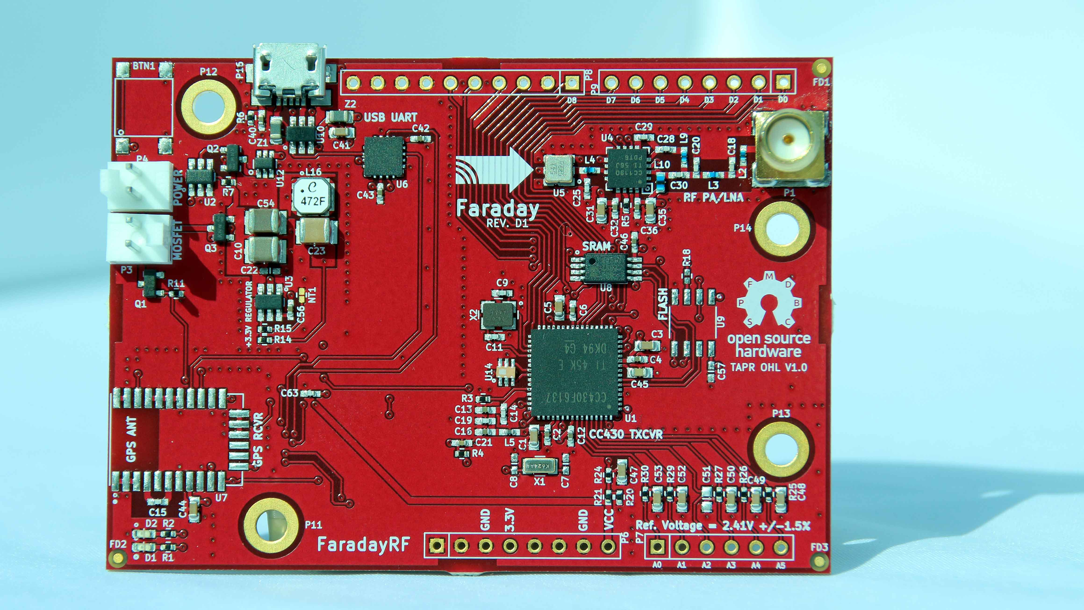
Faraday Wireless Radio
Notes:
12/29/17
15
15

Slide 16
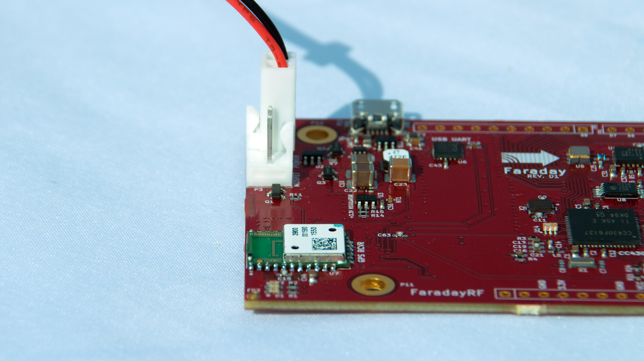
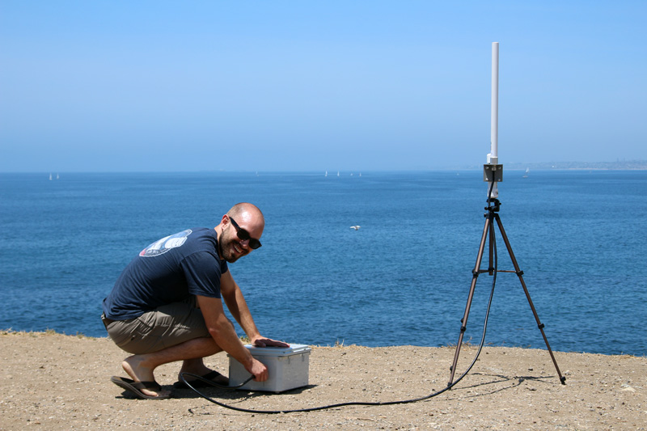
Faraday Wireless Radio
FaradayRF is an open source company who’s mission is...
“To educate and enable radio amateurs to advance the state of ham radio”
Faraday is the first radio and licensed under TAPR OHL V1.0
400mW 2-FSK operation in the 33cm ham band
500kbaud maximum provides medium speed communications
Fully open-source software and firmware on GitHub
Notes:
12/29/17
16
16

Slide 17
ITAR
AMSAT
Open
Source
Notes:
So here we are. Three great tastes that don’t taste great together.

Slide 18
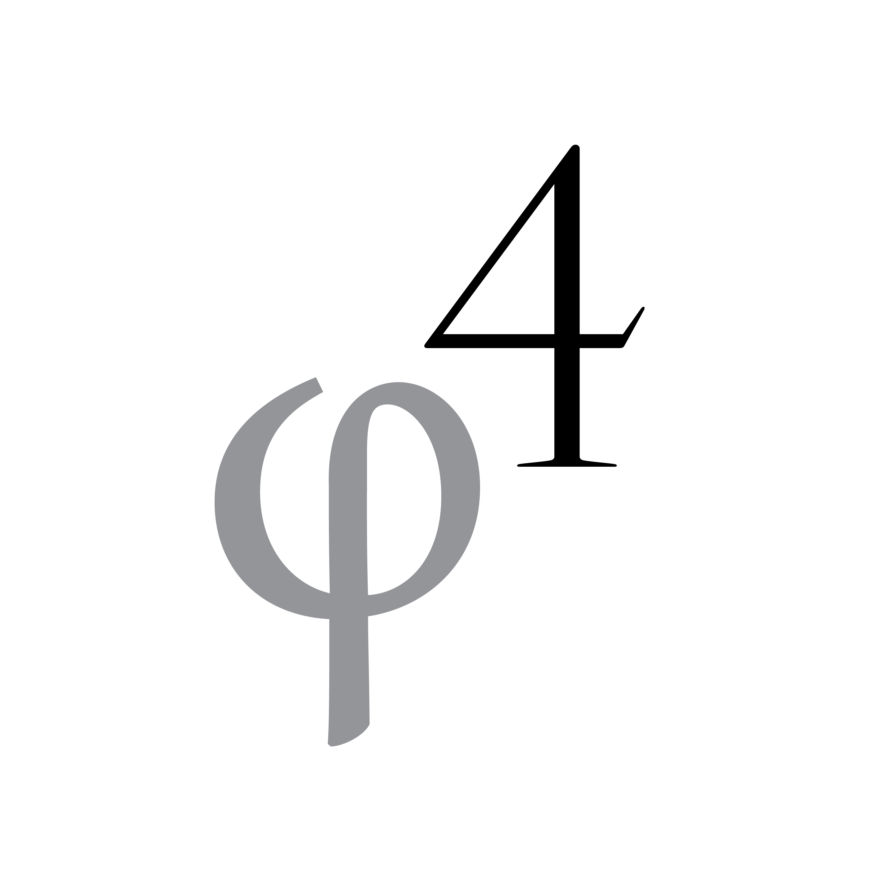
ITAR
AMSAT
Open
Source
Notes:
And this is where we found ourselves in 2008 when we first attempted to make a broadband digital payload for AMSAT, under ITAR.
Who is we? What are we doing? We’re called Phase 4 Ground and we’re a team of volunteers working to bring an open source implementation of DVB-S2 to amateur radio for satellite and terrestrial use. https://github.com/phase4ground
This system is frequency division multiple access up to a payload, where the signals are digitized and processed and then transmitted back down in one time-division signal. It’s frames all the way down. Our downlink protocol is DVB-S2. The uplink is a bit simpler, it’s 4-ary minimum shift keying, or 4FSK. The heart of the payload is a polyphase filter bank, queueing, and framing. It is so fun! We are awesome! You should join our team. https://github.com/phase4ground
Our amateur-centric implementation of DVB-S2 uses generic stream encapsulation, or GSE, which is part of the DVB family of standards, instead of being limited to an MPEG transport stream. In other words, we use the GSE protocol to ship all kinds of data, not limited to video, with very low overhead.
Why broadband? Why digital? Why microwave?
Moving to microwave digital broadband amateur satellites is necessary. Smaller antennas, enormous bandwidths, amazing digital magic, learning modern tools and techniques, and advancing the radio art. And there’s no more room in VHF/UHF and NASA and others say legacy communications services are no longer a justification for launches.
This is an existential crisis going on right now.
Hamcation 2008 I was part of a workshop to present microwave broadband satellite links. I misunderstood what the amateur radio organizers meant by “making sure I committed myself to education”. They didn’t mean students in schools. They meant the ham community.
Having to repeatedly defend digital broadband microwave over and over to the amateur radio community, especially the satellite community, was one of the biggest consumers of my time as a project lead. So I stopped doing it. To me it’s a film vs. digital camera argument and if you want to spend time in a darkroom that’s great but don’t say it is the only choice.

Slide 19
ITAR
AMSAT
Open
Source
Notes:
When we restarted in 2015, we wanted to take advantage of open source software, but this part of the Venn diagram is a painful place too.

Slide 20
ITAR
AMSAT
Open
Source
Notes:
This is our primary organizational innovation. GTFO. Traditionally ground station was commercial gear you went and bought, but how many ham radio stores have a 5GHz up and 10GHz down digital radio waiting for you to use with AMSAT’s future payloads? In order to have an advanced payload we’re going to need to have advanced radios.
Current state of the art in amateur radio microwave tends to be bespoke narrowband contesting rigs. We want a lot more of those, and we want to make them manufacturable, less expensive, and digital.
We are making ordinary microwave transceivers. Nothing we were going to do had anything to do with ITAR. Why stay combined with the payload project?
Split off! Go open source! Define an air interface between the payload and the ground and then enforce a wall between the two projects.
We still need a central node, since we’re primarily a star network with the central node in the sky, when it’s a satellite. Why not have the same thing on the ground and call it a satellite simulator.
We ended up calling it our Groundsat.
Our radios and this Groundsat have no ITAR content in them. The communications package is ordinary communications. Anything that might be space related must be public domain. We were able to share our work on github and recruiting improved by two orders of magnitude within months.
Our primary prototyping tool, and the framework that is used for our reference design, is GNU Radio.

Slide 21
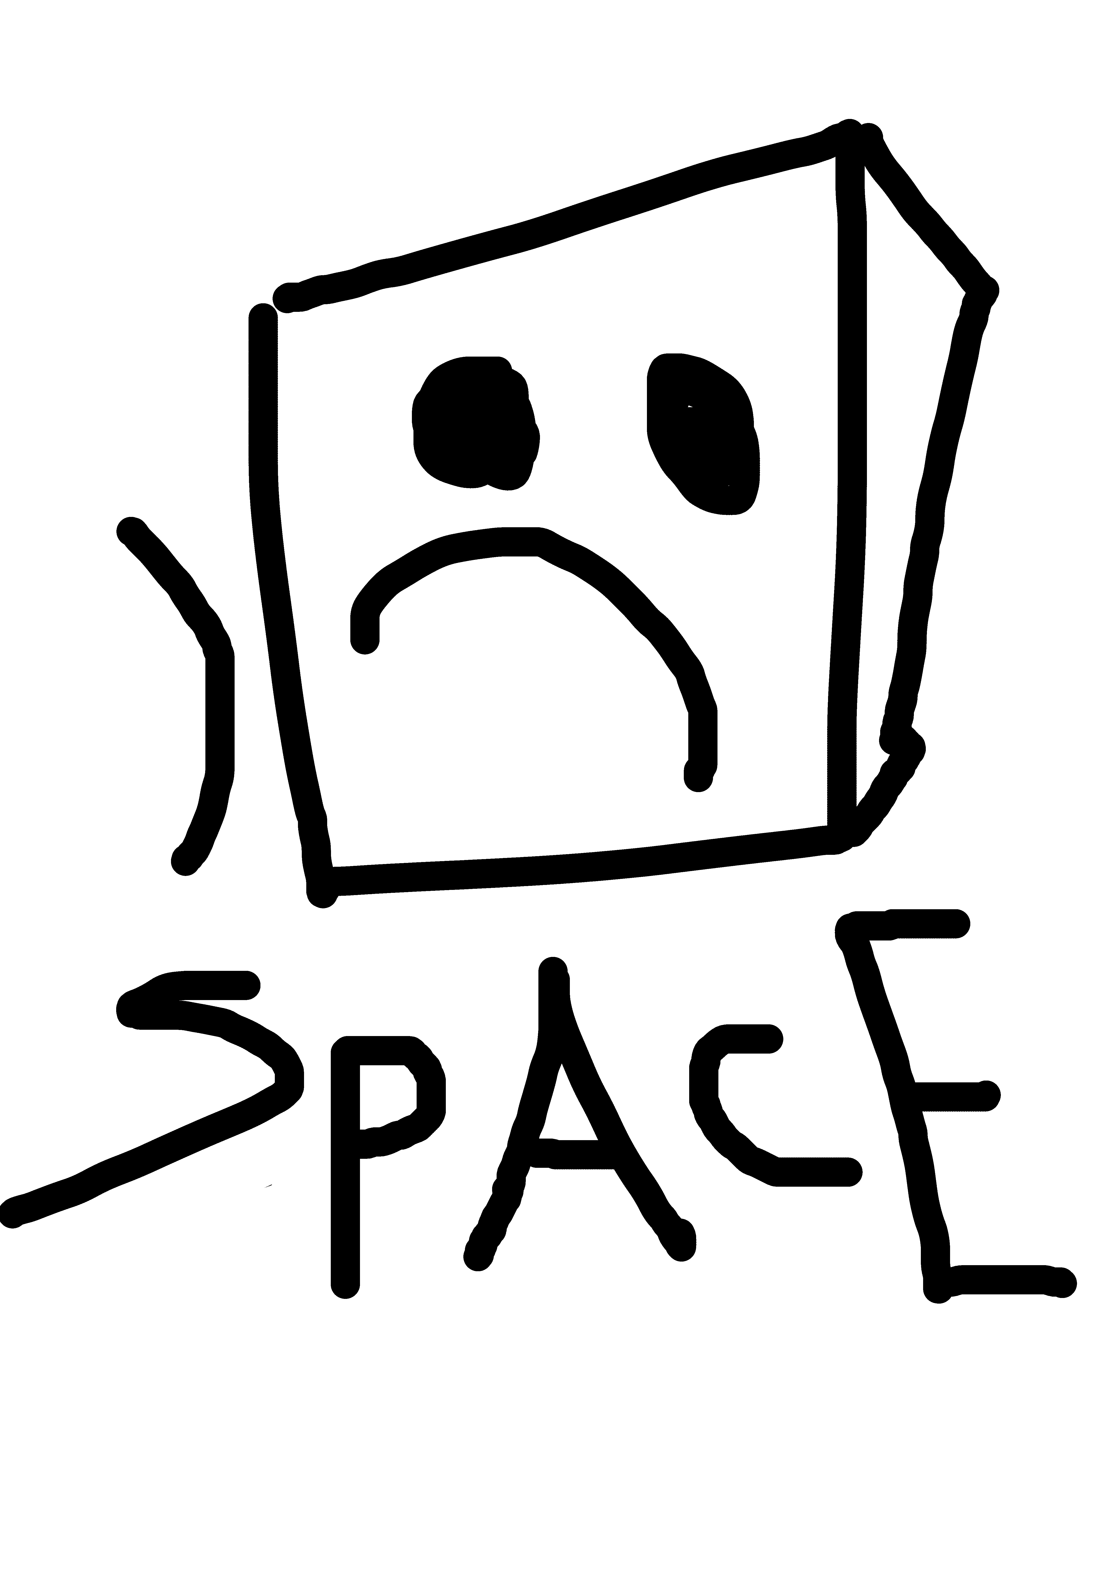


Slide 22
Common Air Interface Document

Slide 23
ITAR
AMSAT
GNU
Radio
Open
Source
Notes:
We Are Bathed in a sea of GNU Radio! GNU Radio is an open source digital signal processing framework for software defined radio. GNU Radio allows computer science to take its rightful place. Defining hardware. Controlling hardware. Defining waveforms. Deriving meaningful data out of signals that sound like noise. It is a golden era for software defined radio and GNU Radio is absolutely central. It is computer science coming around and telling everyone to step back. Competent things can happen now. Legacy modes go home.

Slide 24
ITAR
AMSAT
GNU
Radio.org
Open
Source
Notes:
Find out about GNU Radio at GNU Radio.org
GNU Radio annual conference.
GNU Radio YouTube with all conference presentation videos and monthly developer conference calls.
GNU Radio proceedings over past two years.
GNU Radio mailing list, slack, webpage, active development. Cool swag. And a very long list of desired features and improvements.

Slide 25
Challenges
of the
Venn Lands
Notes:
Each of these Venn-lands offers additional challenges.
This is the doing part. As in, what needs to be done, from our point of view.

Slide 26
“Backup Plan”
“Balance”
“Wait for Launch”
There are two payloads in there with “digital telemetry under voice”
Notes:
Institutional Opposition
The Three Burdens That incident at Hamvention 2008? The hostility to digital communications in amateur radio? It’s still going on. “Believe it or not, the "but we need a backup" argument almost eliminated any digital at all from the Phase 4B payload in early 2017. Digital was allocated 10% of the bandwidth at best, but only after the payload would be all analog for the first year. It took repeated, lengthy, uncomfortable conference calls in order to get the "backup" transponder modes moved to the bootloader, where they actually could be of some service as a backup, instead of nuking the entire bandwidth in a quasi-permanent state. It didn't matter that the link couldn't even be reliably closed with an analog transponder. It didn't matter that a big honking FPGA would be wasted in space by doing this. It didn't matter that the negative performance effects from having a transponder in the same band as the tiny rump of digital were a big problem. This did change, but it was hard contentious work. The most effective aspect was that the people actually doing the work weren't interested in being ordered to implement nothing more than a backup plan. That's why was have the term “Backup Plan Burden”. Backup Plan in this context is a loaded term. It's what was used to justify limiting digital modes on the AMSAT Fox program to a "telemetry under voice" approach, it was used to neuter SDX before that, and has already come up with the next generation AMSAT cubesat GOLF discussions. The problem? It's as if a failure of a digital mode is somehow worse than a failure of an analog mode. If analog sats are allowed to fail, and they definitely are allowed to fail, then perhaps digital satellites should be allowed to fail with at the same rates.
AMSAT needs an open source payload project team. Phase 4 Ground is currently working to kickstart this team.

Slide 27
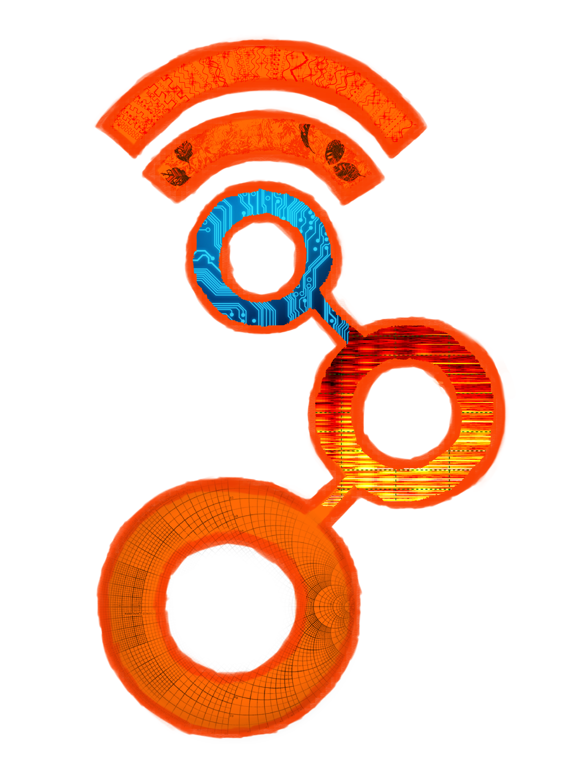
Notes:
GNU Radio has a creaky run-time that needs some renovation so it can continue to dominate.
That’s straight from the president of GNU Radio Foundation. There’s a window of opportunity here to take big strides forward.

Slide 28

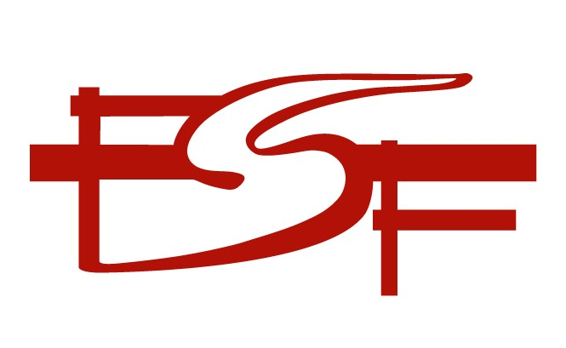

Notes:
Software open source licensing has lots of different license types.
It can cause trouble, lots of trouble, when you mix and match.
For example, Rhode & Schwartz had an excellent student competition last year. It was a DVB-T GNU Radio block competition. Significant improvements and optimizations resulted.
However. The winning blocks couldn’t be included in GNU Radio until licensing issues were solved. That may not have happened yet.
Hardware is much more difficult to open source than software. Open source licenses for software are based on copyright law, and copyright does not apply to most physical objects.
For example, this Fox1B 3D printed model.
One of the primary functions of open source movement is to repatriated knowledge back to the public domain.
This directly benefits projects that suffer under ITAR, like virtually everything AMSAT does.

Slide 29
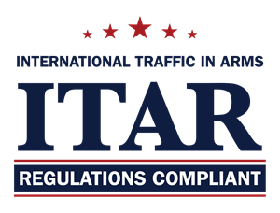
Notes:
Needs to be completely rescinded. ITAR kills the free exchange of ideas and information that are not at all classified or endanger our security. The export of actual defense systems is regulated by treaties, agreements, and other export control provisions.
Here’s some quotes:
“It is easy to complain about the many bureaucratic layers that are embedded in ITAR. The complexity is such that observance of ITAR is rarely based on observation of its provisions, but rather out of fear of prosecution from inadvertent transfers. Further, its outdated provisions undermine its credibility as an effective tool for export control. The reform initiative will not change that reality.”
And
“ITAR places the burden on the developer, researcher, or person possessing information. Essentially, every US person is expected to know and understand the USML (“the list of stuff you can’t export”) in order to prevent transfer of ITAR technical information to a non-US person. Since an export occurs with a mere email message or verbal communication, ITAR expects total familiarity with the USML (“the list”), and for researchers in certain fields to exercise great restraint in scholarly communications.”
From
The Decline and Fall of the ITAR Empire by a bunch of PhDs in 2013
http://www.potomacinstitute.org/steps/featured-articles/44-the-decline-and-fall-of-the-itar-empire
IEEE needs to make this a priority. Not just for cool little amateur radio projects, but because one SpaceX and one Elon Musk in the past 40 years is pathetic space industry progress, and we have ITAR to thank for it.

Slide 30
Phase 4 Ground Technical
Notes:
Questions first?

Slide 31
Computer Science
MODCODS!
Restored to its proper place in the universe.
Notes:
While we are making a radio, and have to obey physics, this is really a computer science project.
DVB-S2 is the standard we’re implementing. A big part of that standard is the ability to choose, on the fly, between a variety of modulation schemes and forward error correction code rates.
This is called modcod for short.
And in DVB-S2 you are allowed to change to a new modcod every frame if you want. Why is this such a big deal? Why is this so cool?

Slide 32
Modulation
How large is the alphabet you are using?
How many bits at once can you transmit?
DVB-S2 gives you lots of choices!
Notes:
When we say we modulation we are talking about the physical format of the waveform we send over the air.
For any one sample, how large is the alphabet, how many marbles are in the jar?
Large alphabet, more bits can be sent per sample, but more power is required.
Think about Morse code, or CW. All you have to do is determine whether or not the tone is present. The tone is either present or not, so you can ride all the way down to a dB below the imagination and still copy by ear. If Morse code alphabet was defined with, say, four volume levels, instead of lengths of tones and spaces, then you have to be able to hear the faintest one all the way up to the loudest one. The loudest volume level could not be any quieter or you would start making errors. More bits at a time requires more power.
A lot of people assume Morse code is binary. I claim it’s not. Can you come up with the right classification? Hint: In Morse code, the silences mean something too. Hint: is Morse code a prefix code?

Slide 33
Forward Error Correction
DVB-S2 uses a concatenated code consisting of an outer Bose–Chaudhuri–Hocquenghem (BCH) code and an inner low density parity check (LDPC) code.
Notes:
When we say we coding and code rate, we’re talking about forward error correction.
There are two major types of encoding. Take out unnecessary or harmful redundancy. Source coding, often used for compression. And, put back in useful redundancy. Which makes your signal more resilient as it’s whipping through the ionosphere or bouncing off a water tower or whatever. That is forward error correction coding.
LDPC was invented in the 1960s but more recently became the thing. One of our big tasks is to make an open source implementation of LDPC decoders. And we have started to achieve this goal and have good early results from Charles Brain, a ham and digital communications experimenter in the UK.
Remember ITAR? If we didn’t split off as our own terrestrially-oriented project, we would not be able to collaborate with him, he couldn’t have joined our team, and we wouldn’t have been able to make this progress.
Charles implementation is on an Nvidia GPU and will be able to run under GNU Radio as a GPU accelerated block. Come hell or high water.

Slide 34
Notes:
This is a poster from a recent poster session describing the LDPC on GPU work.
This is software, in the CUDA framework, telling the GPU hardware what to do, to achieve our goals. Software wins!
Now, why do we care so much about forward error correction and modulation?

Slide 35
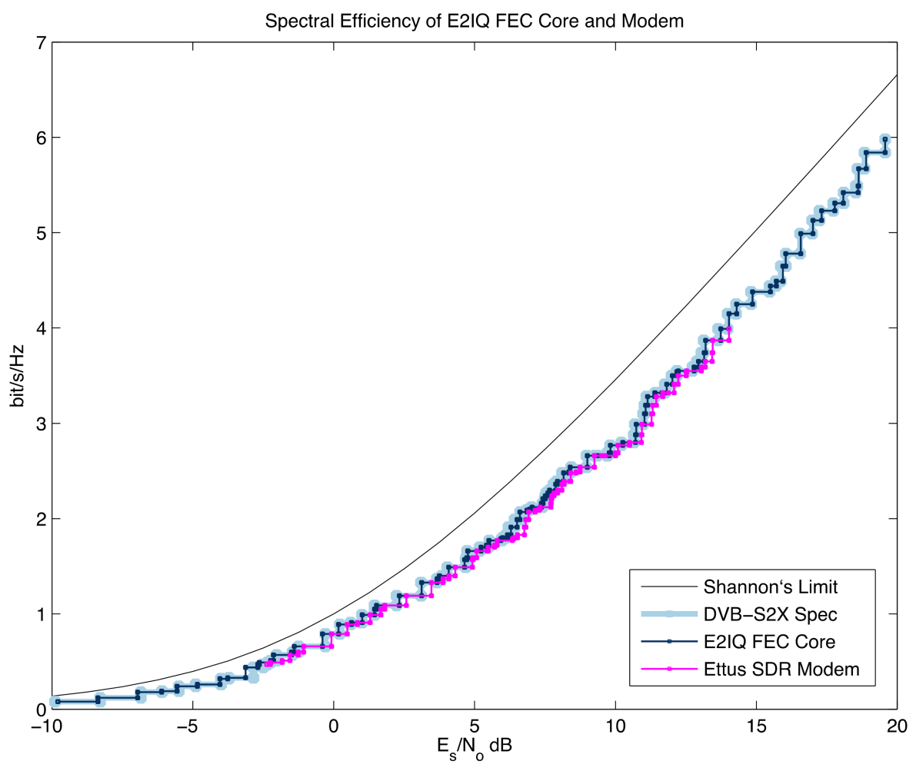
Notes:
This graph here represents fundamental math and physics truth central to communications theory.
X axis is how strong your signal is compared to the noise.
Y axis is how many bits you can cram in until it Hz. Bits per second per Hz. You get more bandwidth in bits, up to a point, limited by signal to noise. By a specific interpretation of noise and signal.
There is a natural limit on how many bits you can cram in there and it’s called the Shannon Limit, named after Claude Shannon, our hero.

Slide 36
Notes:
You cannot go here and be error-free. A fundamental goal of digital communications is to get right up on this curve. We known that some code exists to get us there. Theory doesn’t tell us what that code is, just that it exists. Go get em!

Slide 37
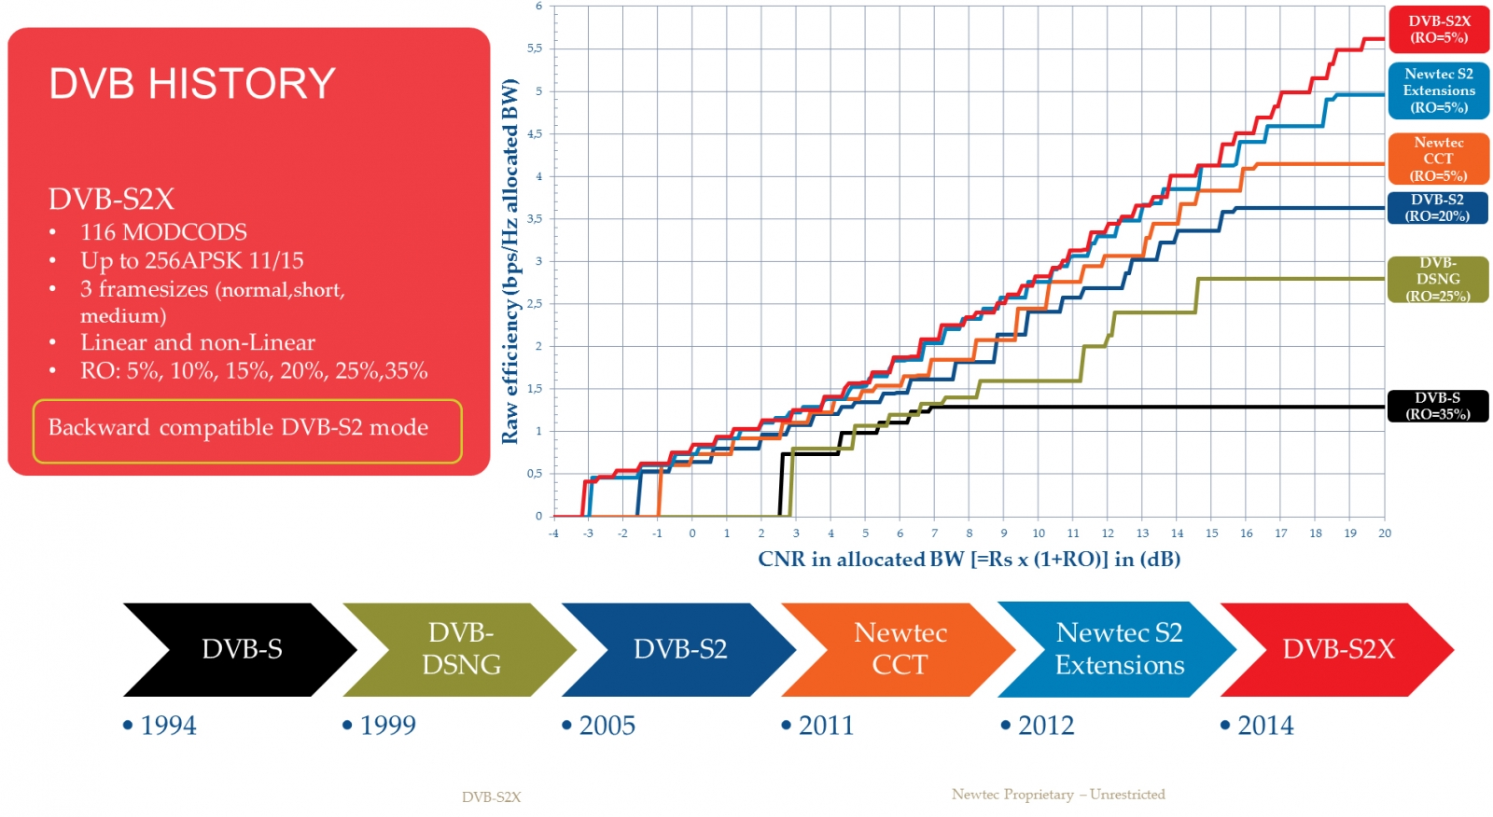
Notes:
This is an awesome graph showing how the DVB-S2 modcods let you traverse the Shannon Limit high wire. These stair steps are individual modulation and coding combinations in various DVB standards. Some have more coding, some less. Some modulation schemes let you send one bit at a time, some a lot more. Pairwise combinations of modulation and coding give you the ability to adapt to the channel and ride the Shannon Limit. That is the heart of digital communications.
This is all possible because of software control. In order to adapt to changing signal to noise ratios, different receiver capabilities, antenna pointing errors, and all that, the software chooses a new position on the graph for you so you can close the link.
Key thing. We have all worked in standards, with standards, against standards…
DVB has hinted that DVB-S2(X) might be it. It’s so close to the Shannon Limit that there may not need to be a DVB-S3. WOW!

Slide 38
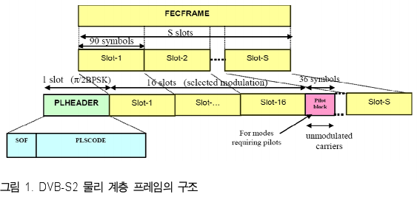
Data Rate = Symbol Rate * Code Rate * Modulation Order
Notes:
Users care about data rate.
In DVB-S2, the symbol rate is fixed. Our modcod choice sets the code rate and the modulation order. That’s how many bits come out that are data bits, and how many bits are sent per symbol, and how many symbols are being sent per unit time. You can see that if you have to code the snot out of it then you have a low data rate.
There are choices of frame size in DVB-S2 and we have chosen the shortest one. This is based on near space communications recommendations from the Consultive Committee for Space Data Systems, or CCSDS.
Look at all the wonderful ways software can get in there. Packets!
LASER BEAMS!

Slide 39
Sponsors
Ettus Research – multiple USRPs
Xilinx – three licenses
Ansoft – HFSS
Slack – nonprofit discount
AMSAT – mailing list, funding
Notes:
Who has helped us so far?

Slide 40
Correlator, Synchronization challenges
Radio interface is HTML5 – no software installs
5GHz RF amplifiers and filters
Dual band feed success!
10GHz receiver chain, clock quality
FPGA coding, GPU coding, GNU Radio coding…
ASIC board that enables DVB-S2X
Art, lots of it!
Telemetry API
Friendly and accessible, learning-positive team
Join at https://phase4ground.github.io/
Notes:
There’s lots more so let’s answer some specific questions.

Slide 41
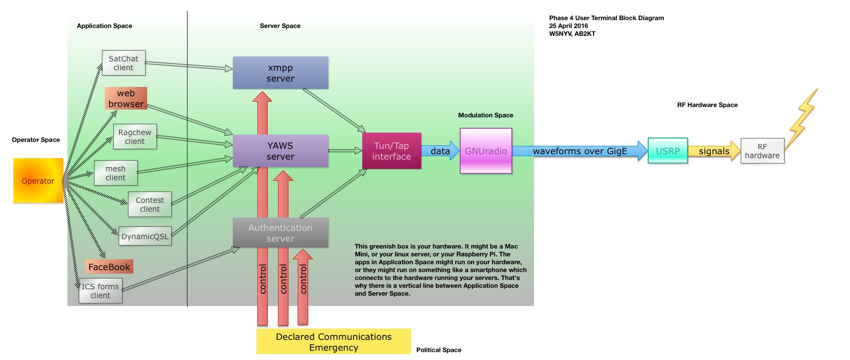

Slide 42
Questions!
Notes:
That’s the landscape we’re currently in.
This is not the end, but some of you I am sure have questions.

